Slide 1
Presentation ON Classes & objects

Slide 2
Contents :
DIFFERENCE BETWEEN C AND C++.
CLASSES.
OBJECTS.
DIFFERENCE BETWEEN OBJECTS AND CLASSES.

Slide 3
DIFFERENCE BETWEEN C AND C++ :
C
C++
C is Procedure Oriented Programming.
C was developed by Dennis Ritchie.
C was introduced in 1972.
C is middle level language.
Data is not secured.
C follows top-down approach.
C++ is an Object-Oriented Programming.
C++ was developed by Bjarne Stroustrup.
C++ was introduced in 1979.
C++ is a high level language.
Data is secured (hidden).
C++ follows bottom-up approach.

Slide 4
C C++
File extension of C++ is .cpp .
It is compatible with Java.
C++ contains 52 keywords.
C++ is an Object driven language.
In C++, classes, objects, inheritence, operator overloading, namespace and polymorphism is possible.
File extension in C is .c .
It is not compatible with Java.
C contains 32 keywords.
C is a function driven language.
In C, classes, objects, inheritence, operator overloading,namespaceand polymorphism is not possible.

Slide 5
CLASSES :
A CLASS represents group of similar Objects.
DEFINATION : It is user defined data type, which holds its data member and member function. It is also a way to bind the data.
For Example : Consider the class of cars. There may be many cars with different names and brand but all of them will share some common properties, like they will have 4 wheels, speed limit, etc. So here, car is class and wheels speed are their properties.

Slide 6
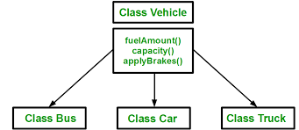

Slide 7
Syntax of class :
classname objectname:
Student S1; //creating an object of student

Slide 8
OBJECTS :
To use the data and access functions defined in the class, we need to create objects.
Objects are created from classes. Classes objects are declared in a similar way as variable are declared.
When a class is defined, only the specification for the object is defined, no memory on storage is allocated.

Slide 9
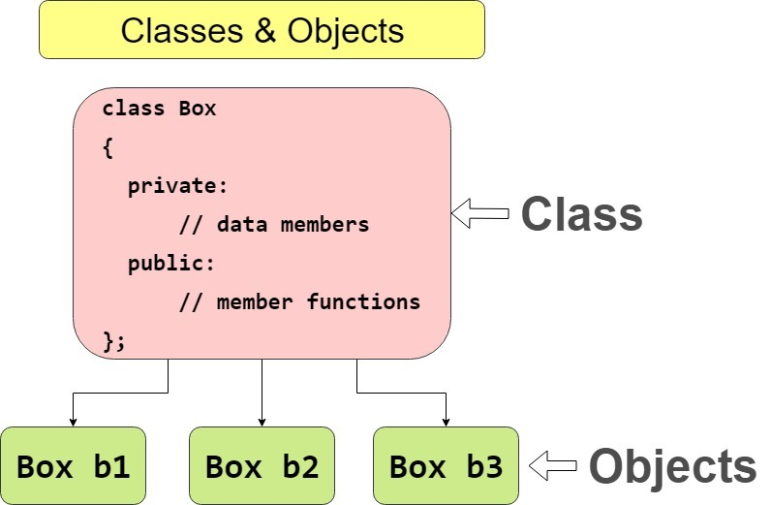
Example of objects :

Slide 10
DIFFERENCE BETWEEN OBJECTS AND CLASSES
CLASS
OBJECTS
A class is a logical entity.
Class is a collection of objects.
Class is declared at once.
To define a CLASS , a class keyword is used .
A Class is used to bind data as well as methods together as a single unit.
For a single class there can be any numbers of objects.
Object is a physical entity.
Object is a instance of a class.
One or more objects created for a class.
Objects do not use any particular keyword.
Objects acts like a variable of the class.
There are many objects can be created from one class.

Slide 11

Thank
you
Download easy ppt’s from:- JP Web devolpers
Follow us on
:
@jpwebdevelopers

